Slide 1

REAL TIME - PEOPLE COUNTING SYSTEM FOR MAKERSPACE
Group: Data Drifters​
Mark sardar, Erik Kavanagh, Hiran Samarasinghe, Aeham Albodiat, Jordan Kent​
Eng4003, section 070​
Professor: Abdullah Kadri​
December 07, 2023

Slide 2


Our Client and the team
Our Client
Stephen Gagné is a professor in the Algonquin College School of business and the Program Coordinator for the Innovation & Entrepreneurship Centre with Algonquin College’s Office of Applied Research, Innovation & Entrepreneurship. At Algonquin, Stephen combines more than 10 years of experience in Entrepreneurship with over 15 years of teaching experience in topics as varied as aviation, coding, photography and public speaking
The Team Mark Sardar Erik Kavanagh
Hiran Samarasinghe
Aeham Albodiat
Jordan Kent

Slide 3

Agenda
Introduction
Project Description
Technical Description
Testing and Evaluation
Future Recommendations
Conclusion

Slide 4

INTRODUCTION
People Counting System—a project that encapsulates the intersection of technology and real-world problem-solving. In a world driven by innovation, the need for efficient crowd monitoring has become increasingly vital, and this project aims to address precisely that challenge. By leveraging advanced computer vision techniques and state-of-the-art hardware, this People Counting System provides a robust solution for accurately tracking and analyzing human presence in each space. As we dive into the details of the project, you will witness the culmination of theoretical knowledge and practical application, showcasing the potential impact of technology on addressing everyday challenges. Let us embark on this journey together, exploring the intricacies of the People Counting System and its implications for a smarter and more connected future.
This Photo by Unknown Author is licensed under CC BY

Slide 5
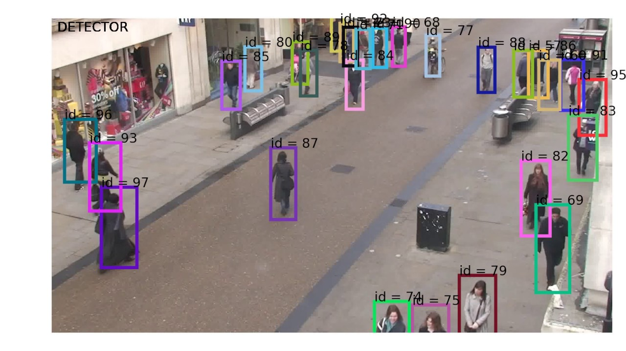
Project Description
Overview of the project
Importance and relevance
Mention the real-world problem it addresses
The goal and objectives

Slide 6
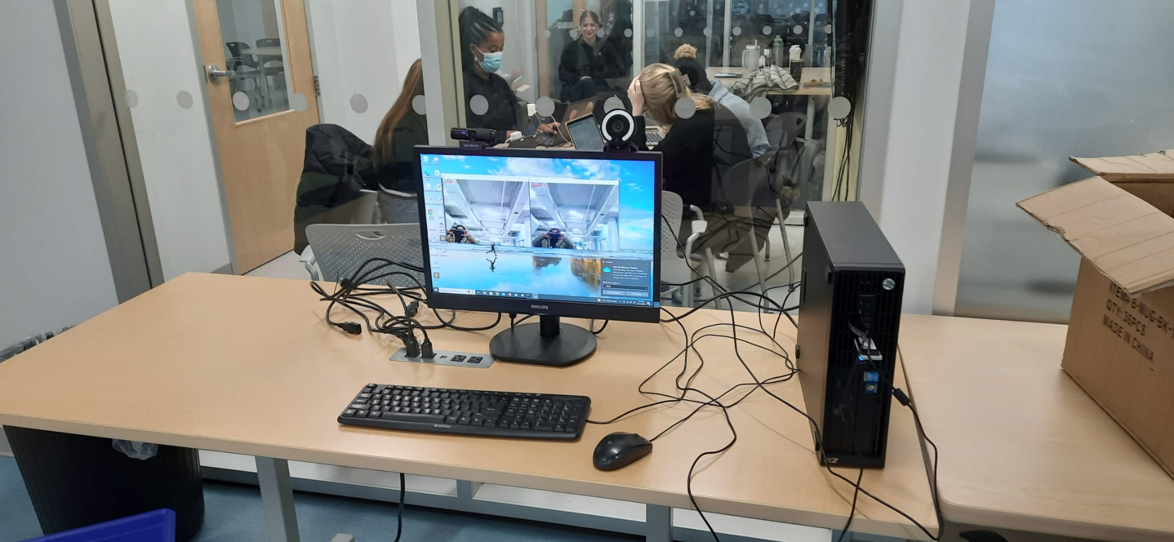

Project Description
Overview of the Project
The People Counting System is an innovative application of computer vision technology designed to address the pressing need for effective crowd monitoring in diverse environments. Leveraging webcam feeds, the system employs Haar-cascade classifiers to detect upper bodies, allowing it to track and count individuals accurately. Through the integration of advanced tracking algorithms, the project achieves real-time monitoring capabilities, providing valuable insights into human presence within a designated space.

Slide 7
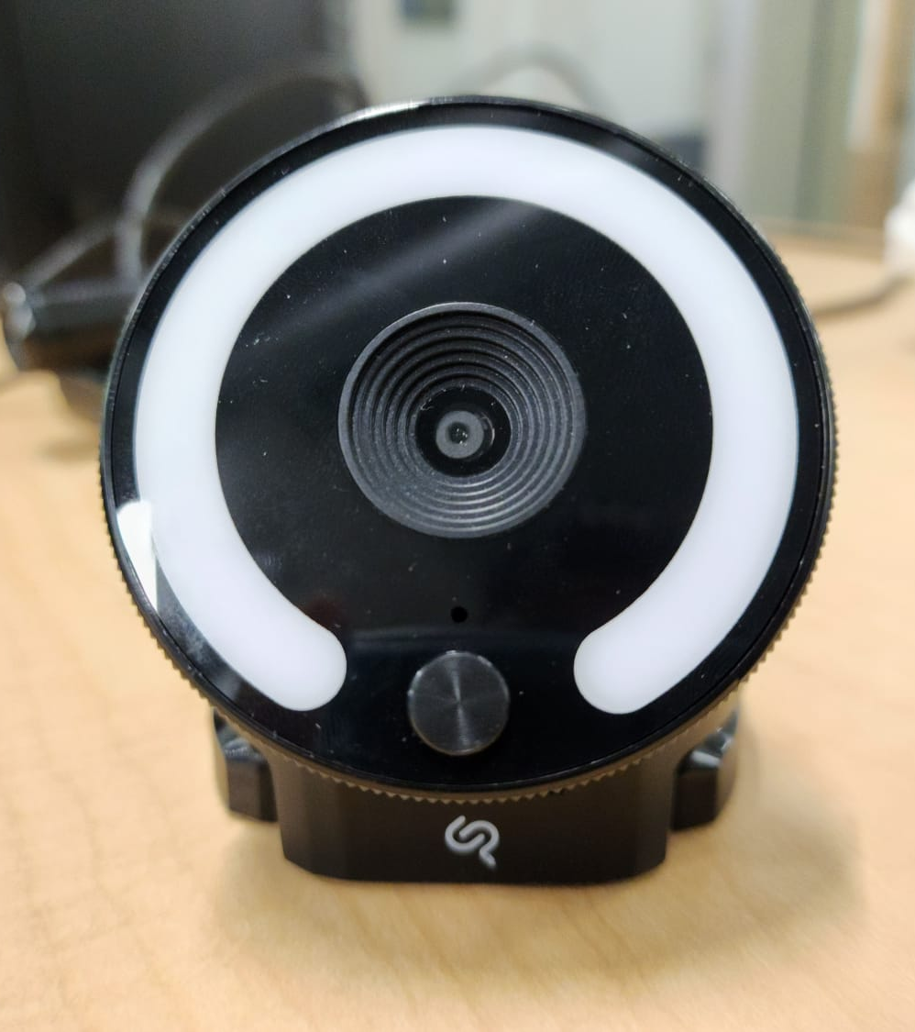
Importance and Relevance
In an era of growing urbanization and evolving public spaces, understanding crowd dynamics is crucial for various sectors. The People Counting System holds significant relevance for retail analytics, event management, and public safety. By automating the counting process, the system not only enhances operational efficiency but also contributes to data-driven decision-making.

Slide 8
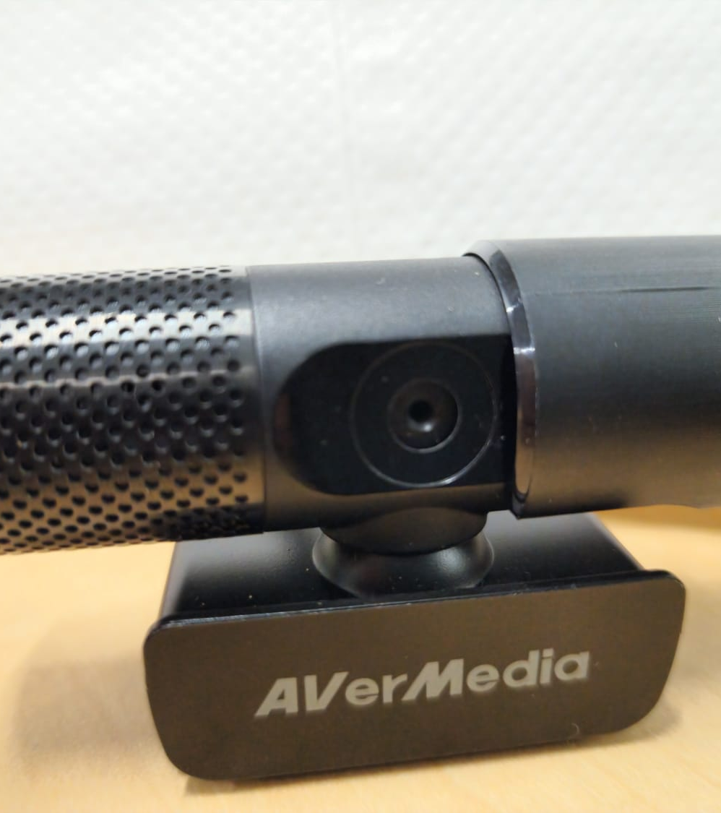
Real-World Problem Addressed
The project tackles the challenge of manual crowd counting, a time-consuming and error-prone task. Traditional methods often fall short in providing accurate, real-time data, hindering effective crowd management. The People Counting System offers a technological solution to this problem, ensuring precise and timely information for improved decision-making.

Slide 9
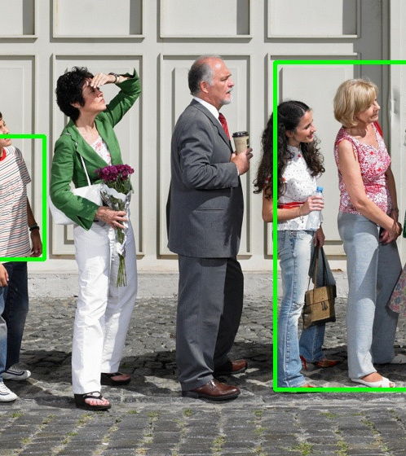
Goal and Objectives
The primary goal of the project is to develop a robust People Counting System capable of accurately detecting and counting individuals in real-time. The specific objectives include implementing Haar cascade classifiers for upper body detection, integrating tracking algorithms for continuous monitoring, and logging data for further analysis. The project strives to offer a versatile and scalable solution that can be applied across various domains for enhanced crowd management and analysis.
This Photo by Unknown Author is licensed under CC BY-SA
This Photo by Unknown Author is licensed under CC BY-SA
This Photo by Unknown Author is licensed under CC BY-SA

Slide 10
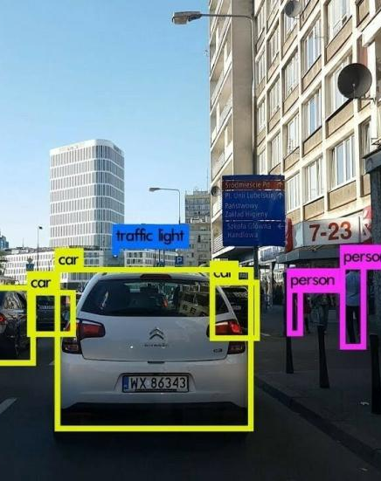
System Overview and Components Used
Hardware Components
Web Cameras:
Used to capture video feeds from designated areas.
Provide input for upper body detection and tracking.
Microcontrollers:
Responsible for interfacing with cameras.
Facilitate the transfer of video data to the processing unit.
Processing Unit:
Executes computer vision algorithms for upper body detection.
Manages tracking and counting functionalities.
This Photo by Unknown Author is licensed under CC BY-NC

Slide 11

System Overview and Components Used
Software Components
OpenCV (Open-Source Computer Vision Library):
Utilized for upper body detection using Haar cascade classifiers.
Implements tracking algorithms for continuous monitoring.
Pandas:
Enables efficient data handling and manipulation.
Used for logging and analyzing detection data.
Python:
Programming language for overall system development.
Integrates various libraries and components.
This Photo by Unknown Author is licensed under CC BY-SA-NC

Slide 12
Technical Description
Detailed Technical Aspects:
Our People Counting System employs OpenCV's Haar cascade classifiers for resilient upper body detection in diverse lighting conditions. Tracking utilizes the Kernelized Correlation Filters (KCF) algorithm, enabling seamless monitoring of multiple individuals. Integrated Pandas ensures efficient data handling, offering timestamped logging and real-time Excel updates for comprehensive analysis. This robust foundation guarantees accurate and adaptable people counting.

Slide 13

Technical Description
Key Features:
Our system delivers real-time monitoring, promptly detecting and tracking upper bodies via continuous webcam surveillance. Supporting multiple cameras, it allows independent monitoring and automated counting for each. Automated data logging timestamps detection counts every five minutes, providing cumulative counts for individual cameras and total detections. These features underscore the system's precision and efficiency in people counting.
This Photo by Unknown Author is licensed under CC BY-SA-NC

Slide 14

The system's high-level architecture orchestrates a seamless interaction among its key components. Web cameras capture real-time video frames, which undergo upper body detection using Haar cascade classifiers. The Kernelized Correlation Filters (KCF) tracking algorithm facilitates continuous tracking across frames. The detected and tracked data are efficiently logged and analyzed using Pandas, with timestamped records and real-time Excel updates. This orchestrated flow ensures a robust people counting system with accurate and timely data capture, tracking, and analysis
System Architecture Overview

Slide 15
DATA DRIFTERS – GANTT CHART
 | Sep 11 – Oct 01 | Oct 02 - 15 | Oct 16 – 31 | Nov 01 – 12 | Nov 13 – 19 | Nov 20 – 26 | Nov 27 – Dec 03
Implementation
Test Drive in Home environment for Diagnose
Testing Phase 01
Documentation
Modification to the System
Testing Phase 02
Testing Phase 03
Completion and Installation
Mark -
Erik -
Hiran -
Aeham -
Jordon -
Team -
15

Slide 16
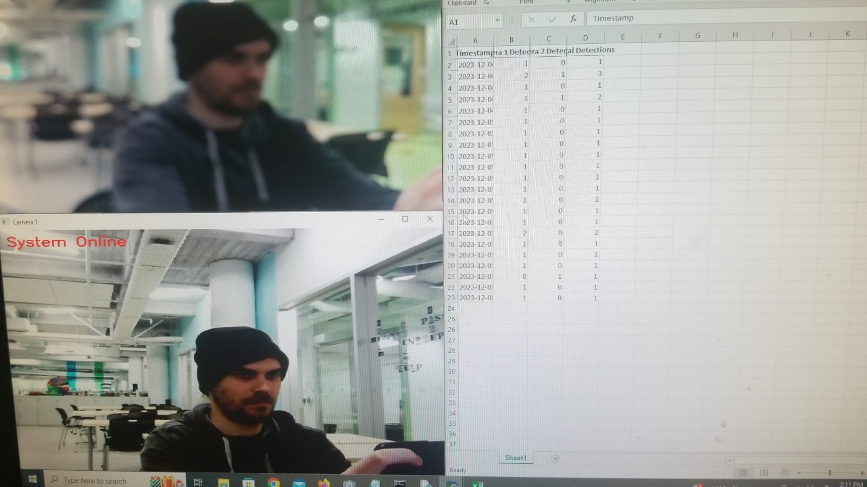
Testing and Evaluation
The testing phase involved comprehensive procedures to validate the system's performance. Metrics such as detection accuracy, tracking precision, and real-time responsiveness were employed for evaluation. The system demonstrated robustness under varying lighting conditions and successfully tracked multiple individuals simultaneously. Challenges encountered during testing were promptly addressed, ensuring the reliability and accuracy of people counting. Results showcased the system's effectiveness in real-world scenarios, laying the foundation for its practical deployment in diverse settings.

Slide 17
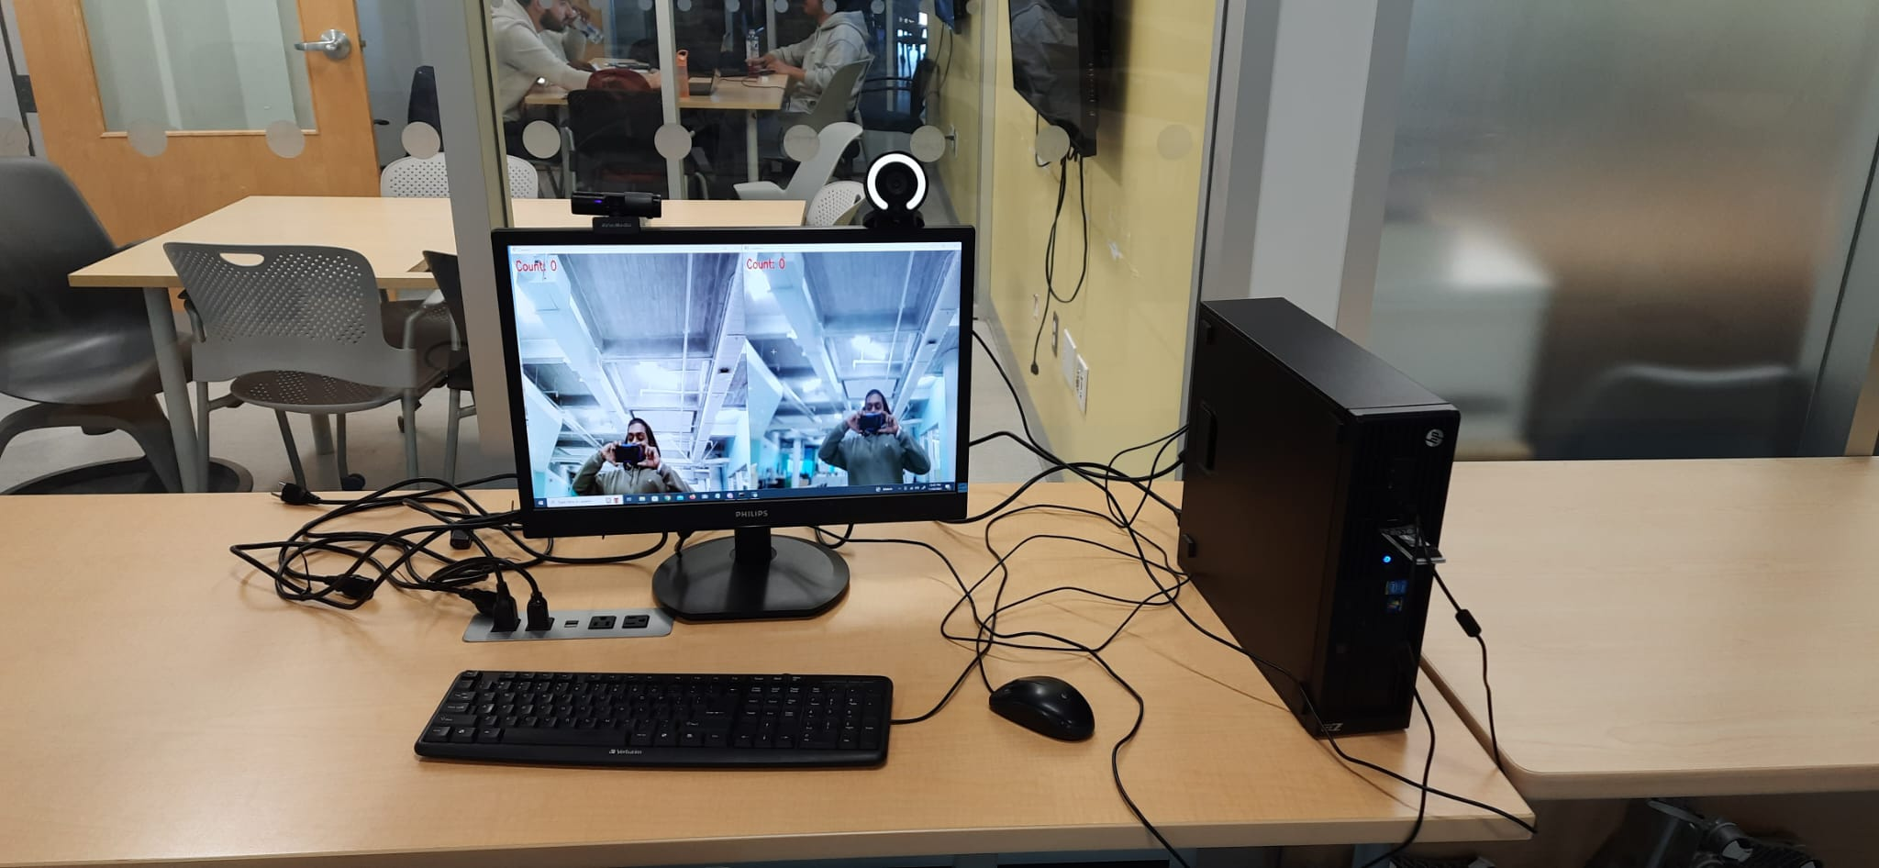

Testing results
Successful implementation of the People Counting System.
Accurate detection and tracking of upper bodies in real-time.
System demonstrated effectiveness under varying lighting conditions.
Simultaneous monitoring and counting from multiple cameras.
Real-time updates of Excel files with timestamped detection statistics.
Positive evaluation results based on predefined metrics.
17

Slide 18

Future Recommendations
Enhanced Detection Algorithms.
User Interface Enhancements.
Cloud Integration.
Extended Hardware Support.
Automated Alerts.
Integration with Access Control Systems.
Privacy Features.
Mobile Application.
Energy Efficiency.

Slide 19

CONCLUSION
In summary, the People Counting System offers a robust solution for real-time monitoring and tracking, employing advanced computer vision techniques like Haar cascade classifiers and the Kernelized Correlation Filters (KCF) algorithm. With efficient data handling through Pandas, the system ensures accurate upper body detection, continuous tracking, and automated data logging in Excel files. Key features, such as support for multiple cameras, contribute to precise people counting. The project's reliability, adaptability, and successful addressing of real-world challenges highlight its significance. Future recommendations outline potential enhancements, positioning the system as an innovative solution with broad applications in surveillance and monitoring.

Slide 20
THANK YOU

Slide 21


